Slide 1
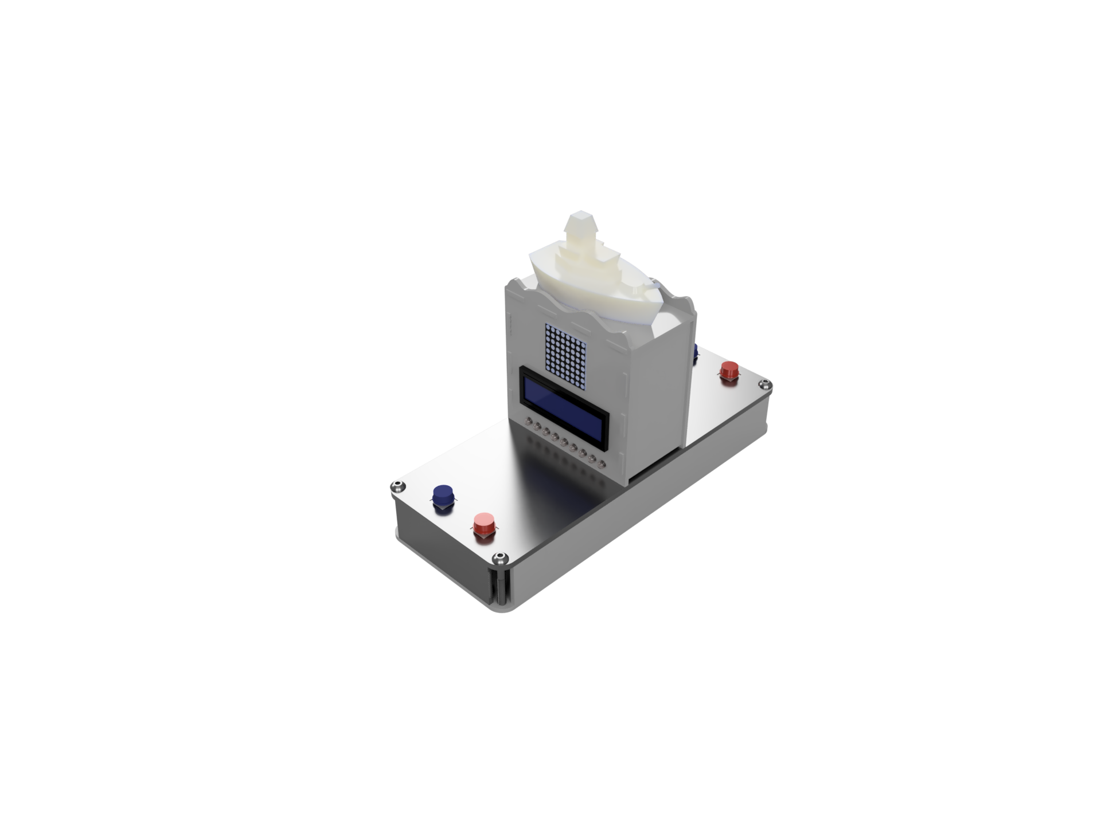



Modern Battleship
DFS Workshop Project

Slide 2
Project
Battleship
2 Players
Players place their ships (each ship occupies different number of coordinates)
Players choose a coordinate to attack
Whoever destroy all opponent’s ship wins
Battleship Interactive
Table with LED and sensors to sense placement of physical ships
Ship will light up when placement confirmed
LED will turn off when the spot is hit
Same gameplay as battleship

Slide 3
Project
Battleship FFA
2 to 4 Players (Players can be computer also)
Same game play Style
Can choose between co-op mode or free-for-all game style
Battleship Tactics
2 Players
Choose 4 stats base on a point buy system
Stats will affect the action numbers in a turn, range of fire, types of ships available, number of ships in beginning, visibility range , etc.
Same game play style as Battleship FFA but ships can move, fire more shots and tactics required

Slide 4
Peripherals
Input
4 X Button
Output
2 X LCD
1 X Speaker
18 X LED
2 X LED Matrix
Other Peripherals
MAX7219
74HC595
Atmel328p
WTV020MP
Green Button
Red Button

Slide 5
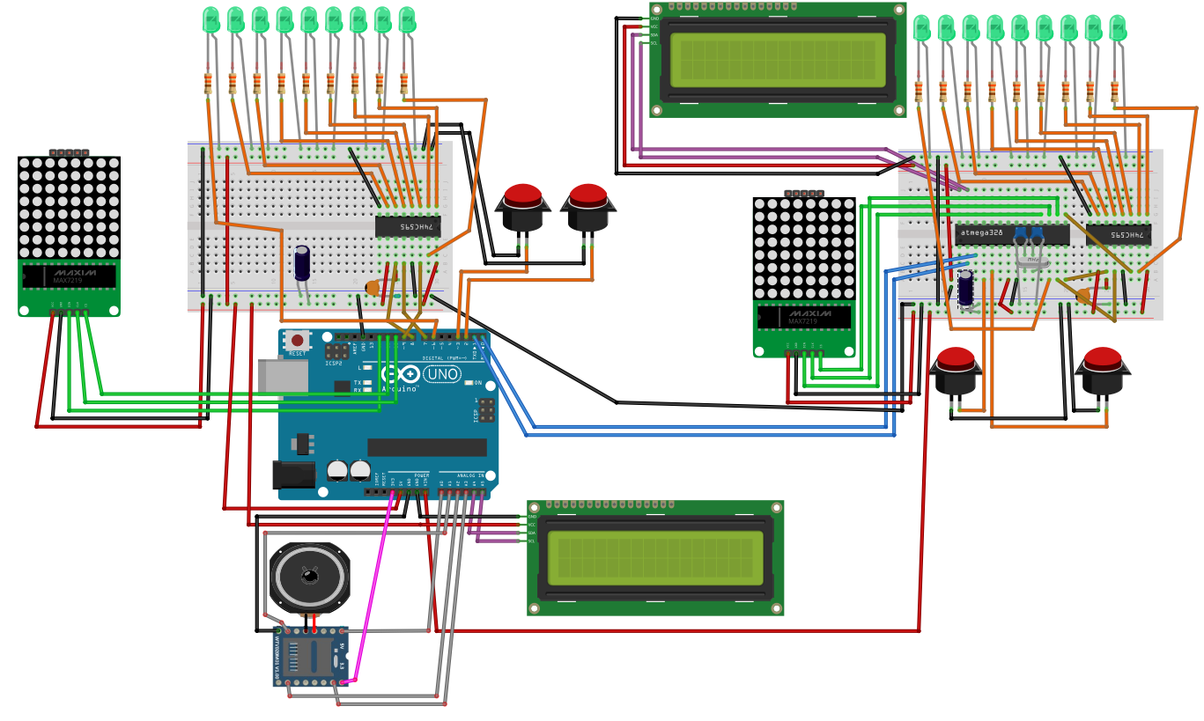
Circuit

Slide 6
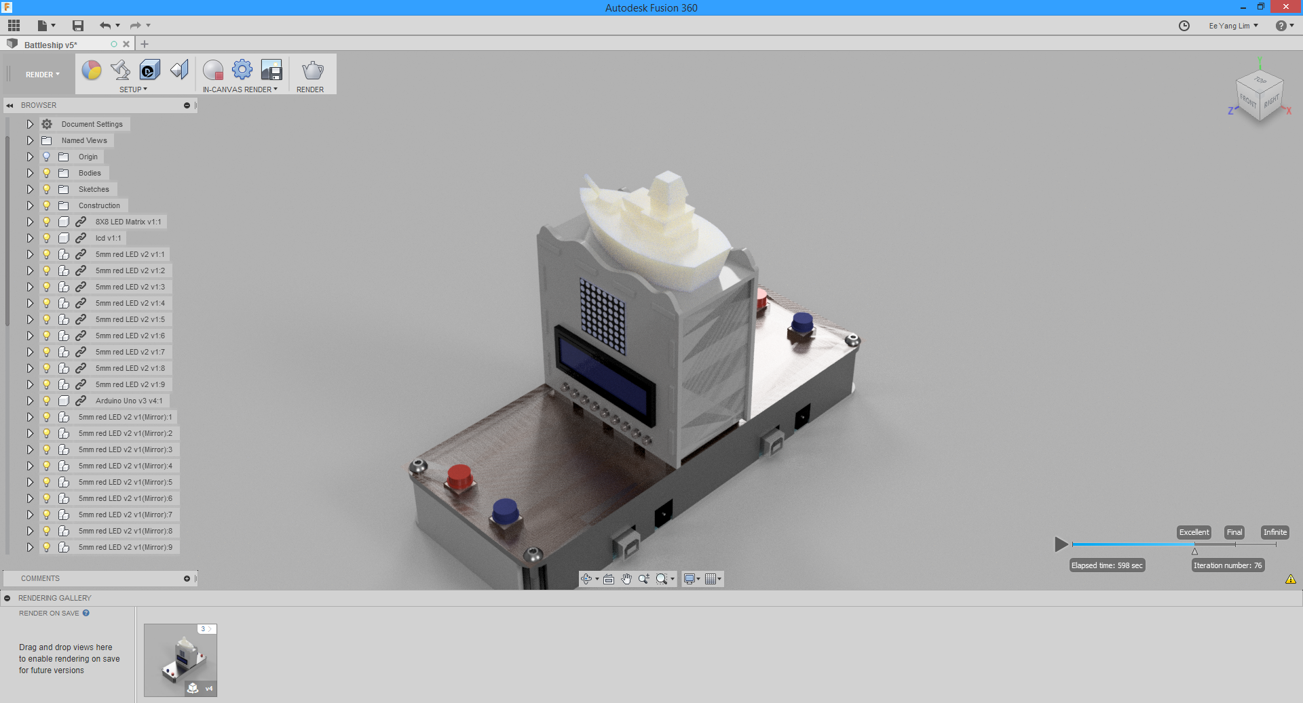
Design

Slide 7
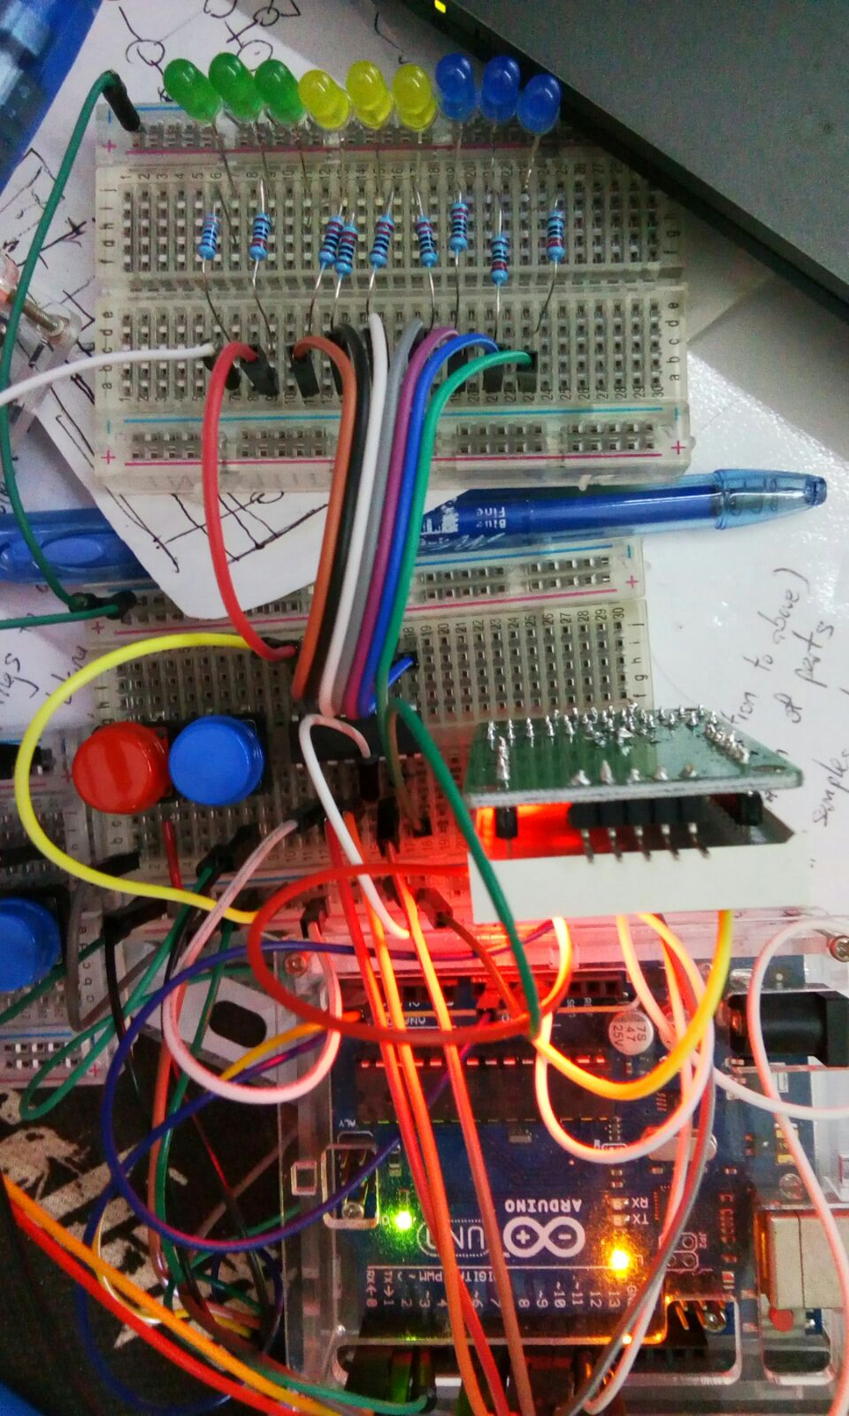
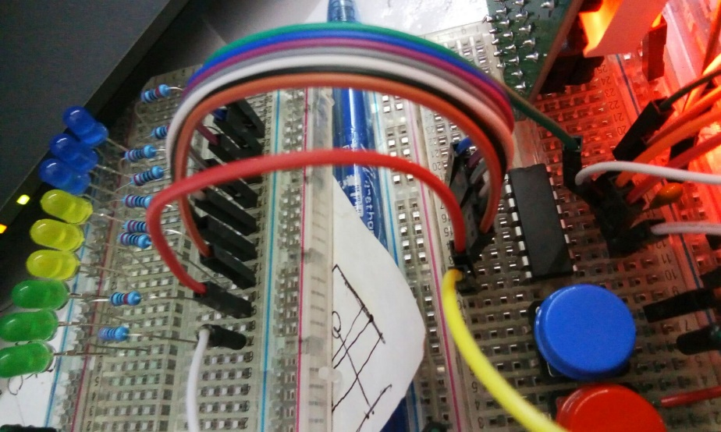
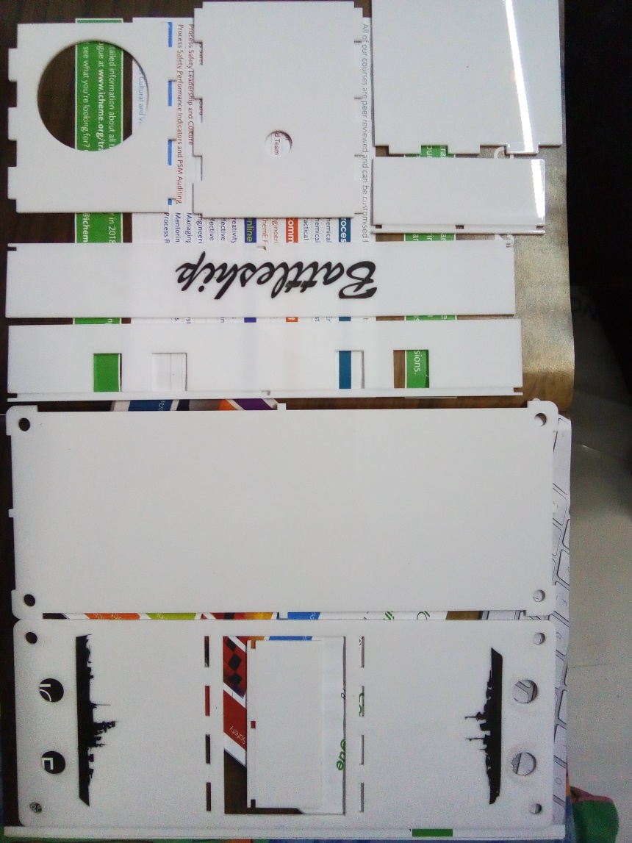
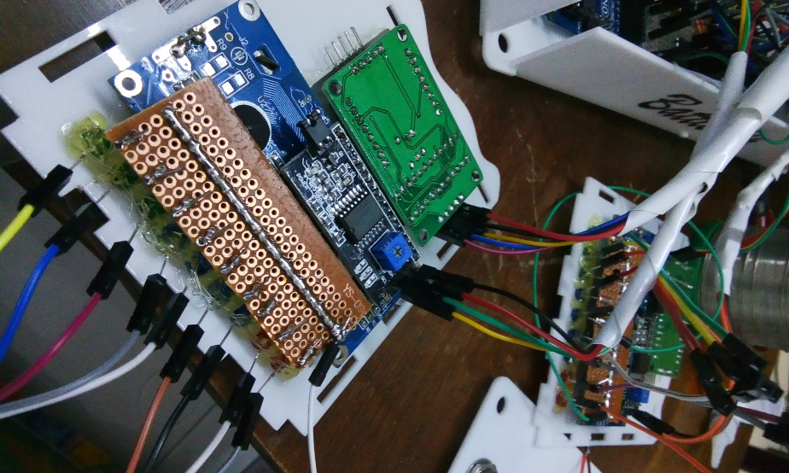
Hardware

